Slide 1

Professor Pranati Panda
Professor and Head
Head, School Standards and Evaluation Unit
National University of Educational Planning and Administration (NUEPA)
17-B ,Sri Aurobindo Marg, New Delhi-110016, INDIA
Phone: 011-26544815
SHAALA SIDDHI
Evaluation For Improvement
School Standards and Evaluation

Slide 2



Slide 3
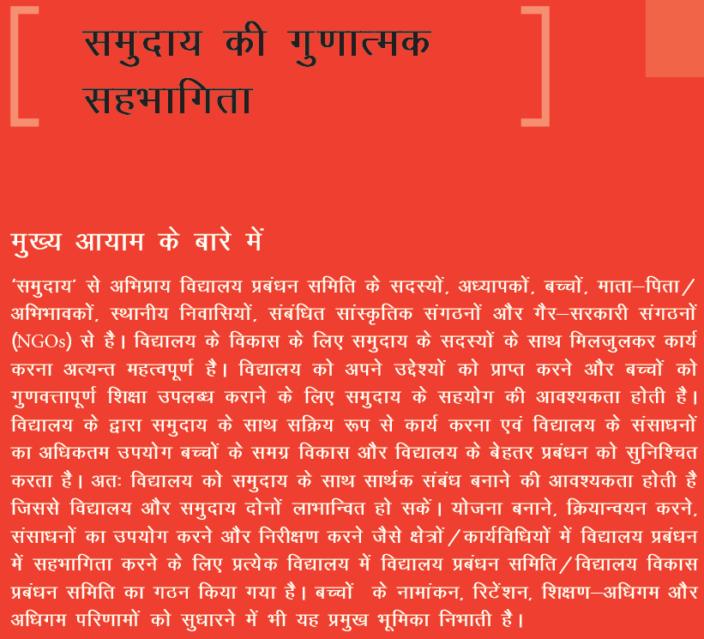

Slide 4
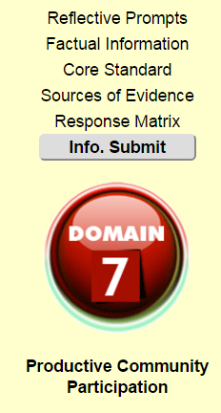
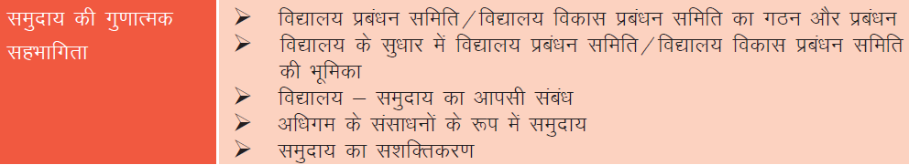

Slide 5
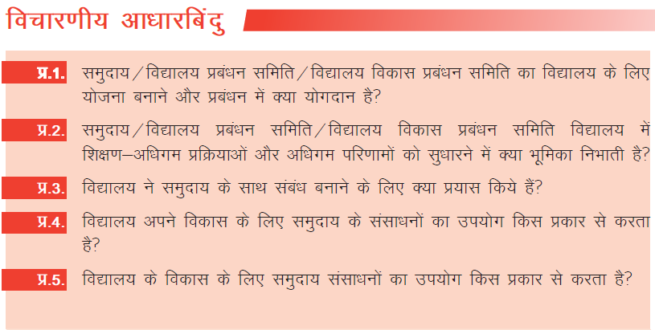
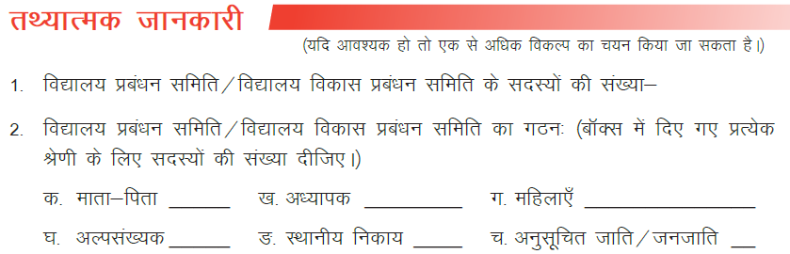

Slide 6
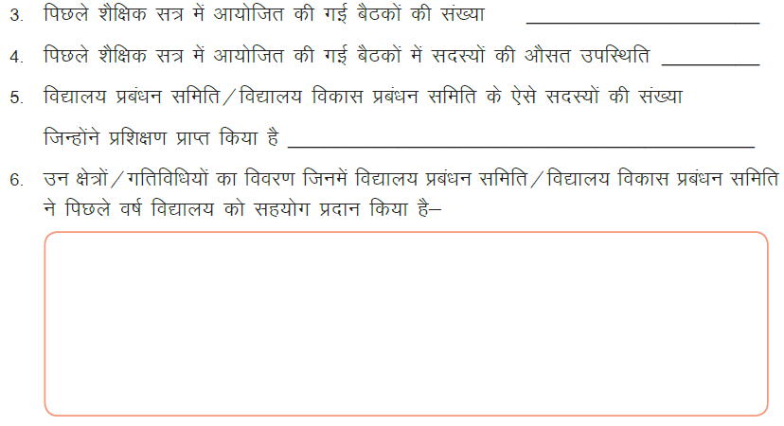

Slide 7
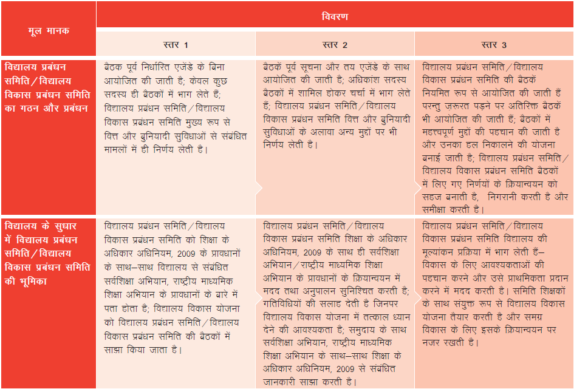

Slide 8
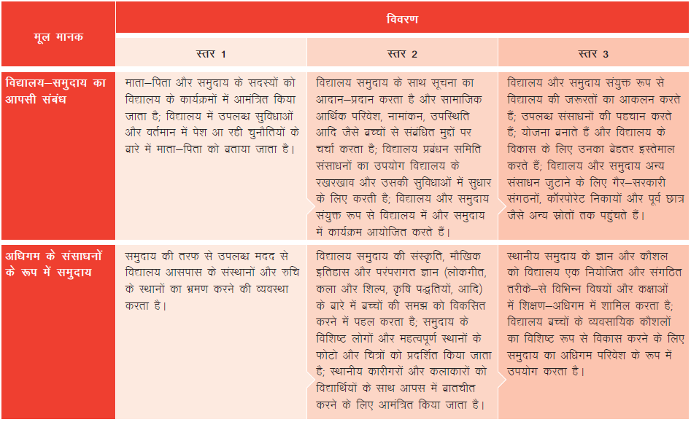

Slide 9
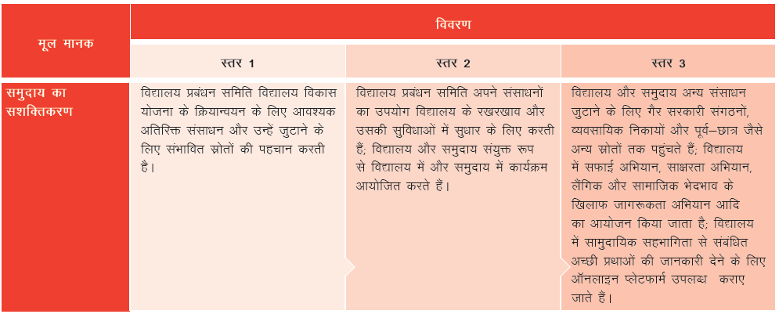


Slide 10

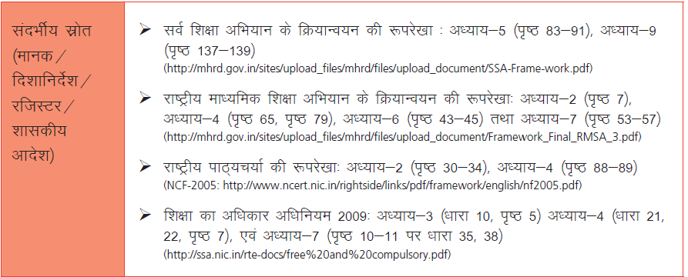

Slide 11
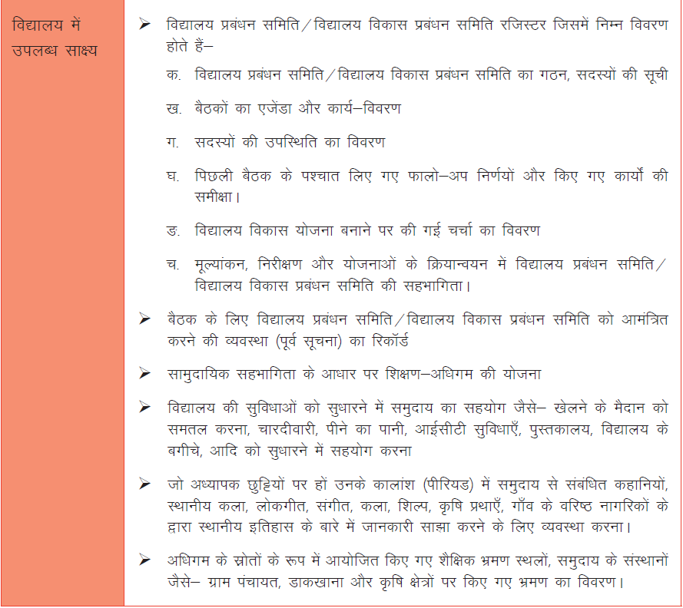

Slide 12
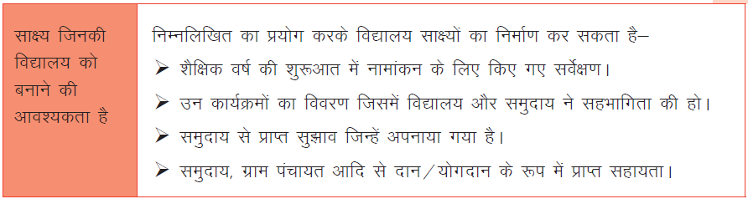
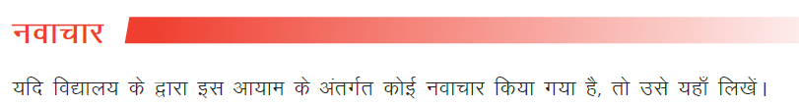


Slide 13

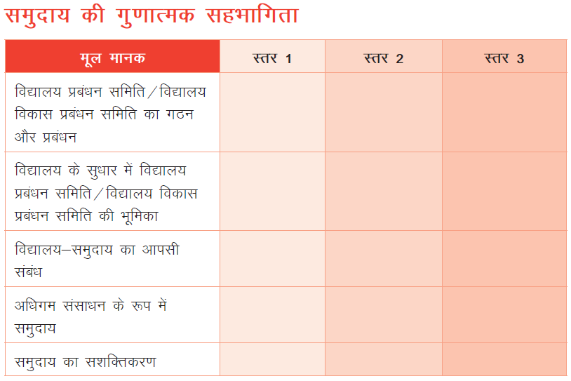

Slide 14
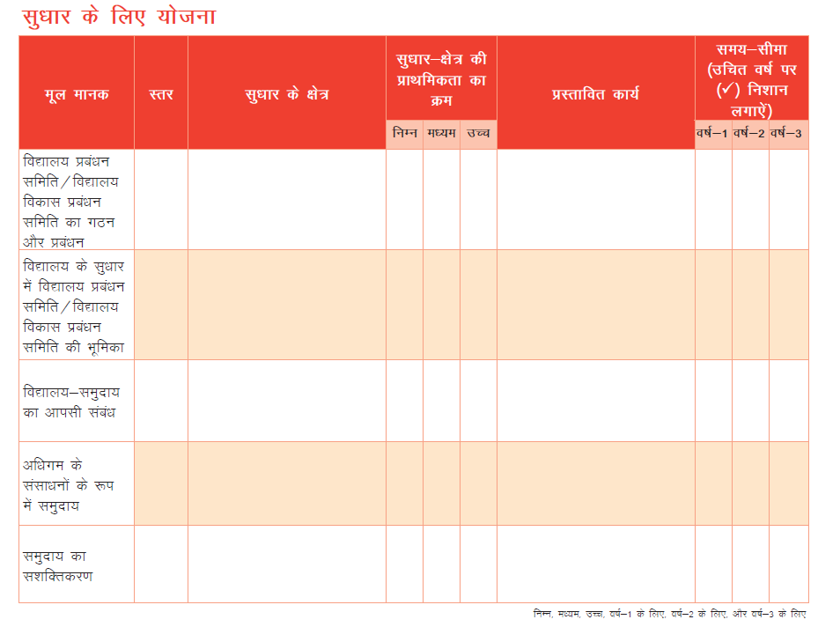

Slide 15
Thank You

